Slide 1
Data Visualization
Best Practices
Spring, 2018

Slide 2
Course Outline
Why visualize
Good practice guidelines
Basic visualizations
Composition rules
Interactivity

Slide 3
Why Visualize?
Data visualization shifts the balance from cognition (thinking) to perception (seeing)
Seeing is handled by the visual cortex located in the rear of the brain, is extremely fast and efficient
We see immediately, with little effort
Thinking is handled primarily by the cerebral cortex in the front of the brain, is much slower and requires bigger effort
Images are processed faster than audio or text
Our brains have powerful image processing which works unconsciously

Slide 4
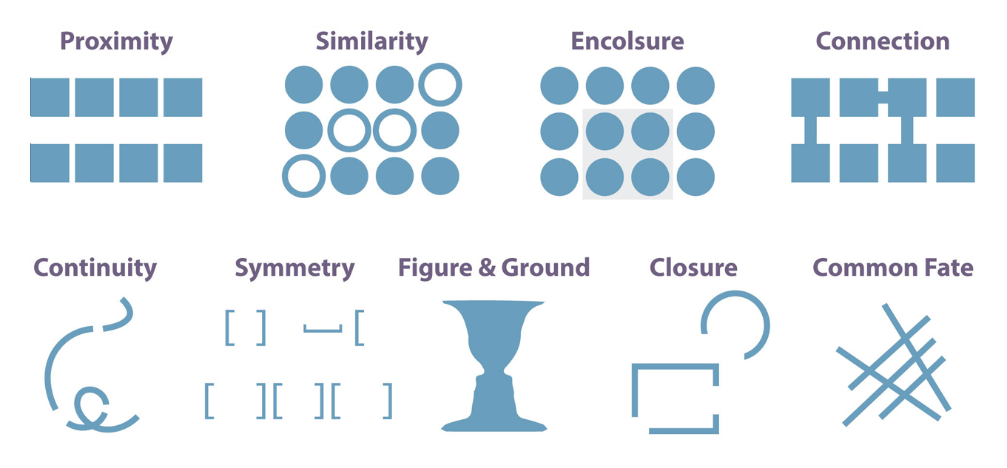
Gestalt Principles of Grouping - a philosophy of mind developed by the Berlin School of Experimental Psychology, “Gestalt” is German for shape, form
Proximity: close together objects are perceived as a group
Similarity: object with same attributes (color, size) are perceived as a group
Enclosure: objects within a boundary are perceived as a group
Closure: open structures are perceived as closed if there is a way to interpret as such
Continuity: aligned objects are perceived as a group
Connection: connected objects are perceived as a group

Slide 5


Exploit Ability of the Human Brain to Infer Simplest Solution for Incomplete Visual Information

Slide 6
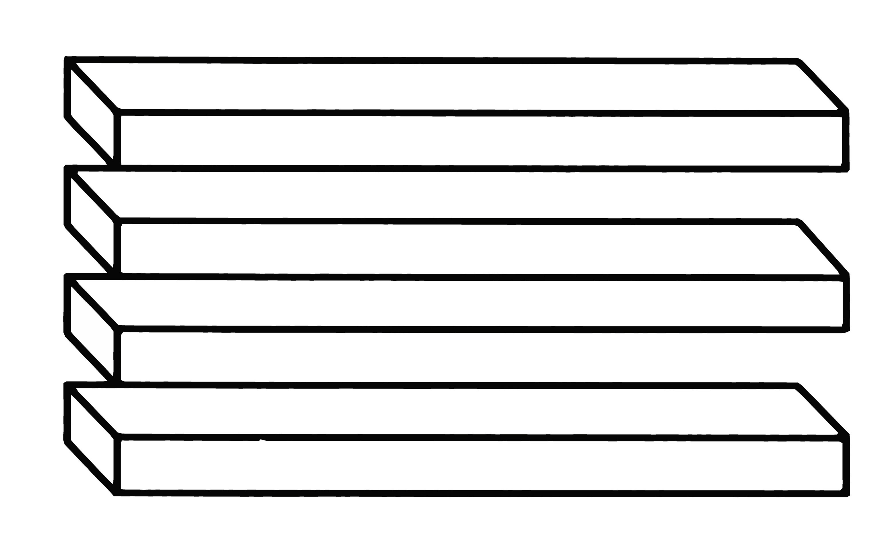
An eye can be fooled

Slide 7
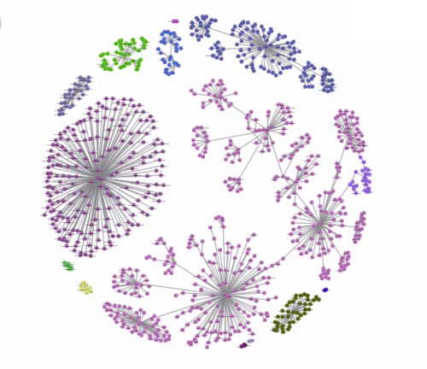
Nice Picture Makes You Interested
Connections
Similarity
by color
Closure: open
round shape
implies globosity
Grape-like arrangement
shows hierarchies

Slide 8
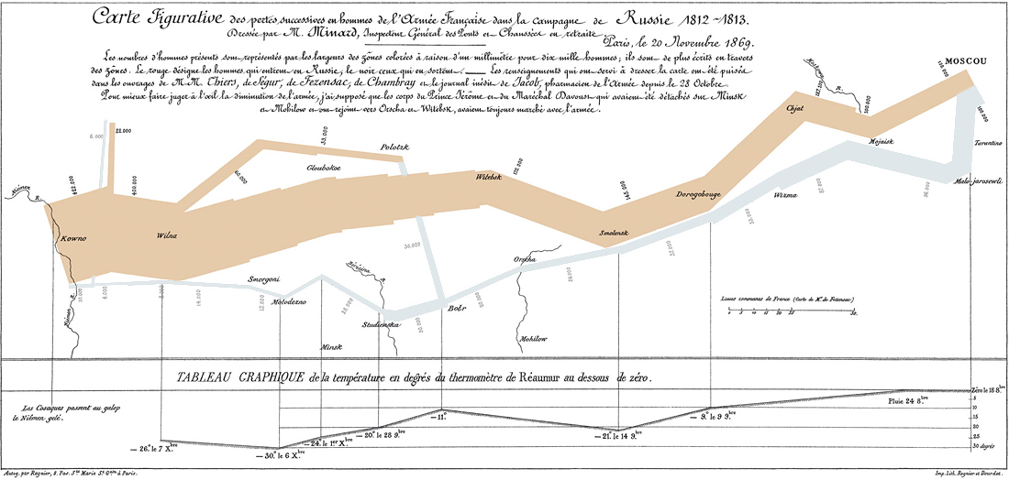
Classic Visualization Charles Minard: Napoleon’s Russian Campaign of 1812
The width of the lines corresponds to the number of troops
The beige color is for the direction to Moscow
The grey color is for the return

Slide 9
Edward Tufte’s Visualization Goals
Explore
Compare
See trends
Relate part to whole
Rank
Correlate
Show distribution
*Edward Tufte, The Visual Display of Quantitative Information

Slide 10
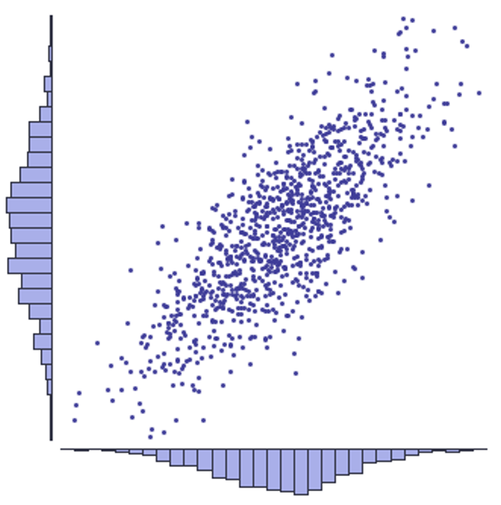
Data Exploration Scatter Plot and Histogram
Histogram
Value
of A
Frequency
of A
Scatter
Plot
Bin
Value
of B
Histogram
Frequency of B

Slide 11
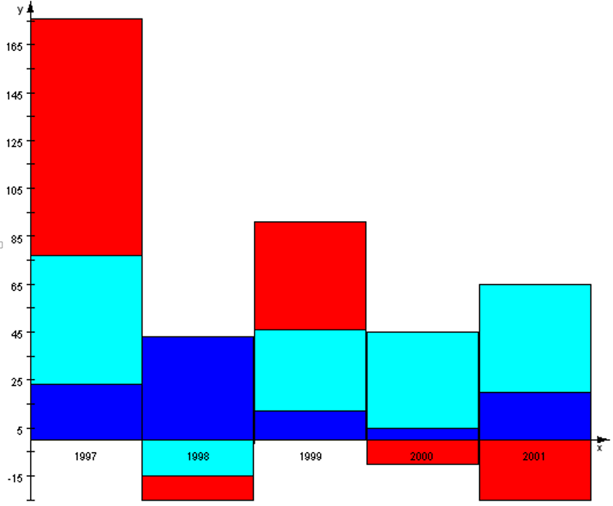
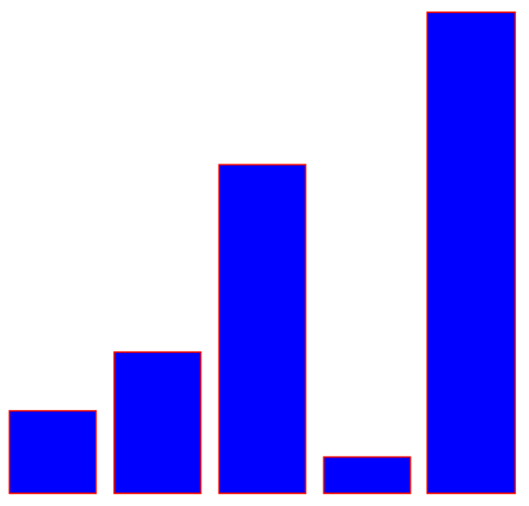
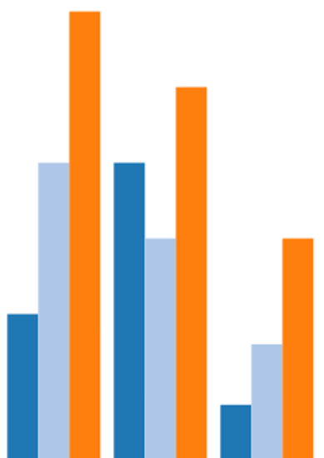
Data Comparison Bar Charts
Value
Stacked Bar Chart
Colored by Value Attributes
Clustered Bar Chart
Colored by Value Attributes
Variable
Bin
e.g. Year

Slide 12
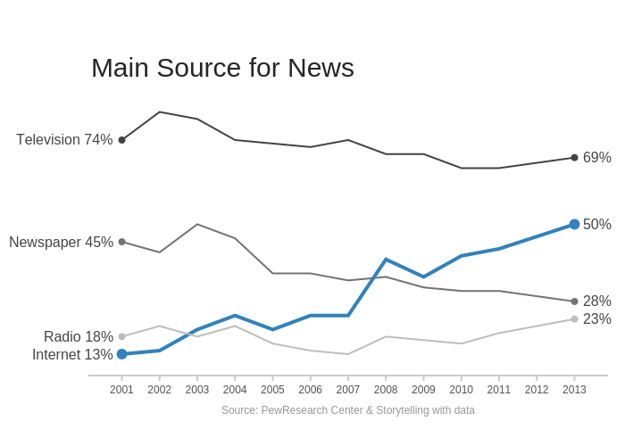
Data Trends Line Charts

Slide 13
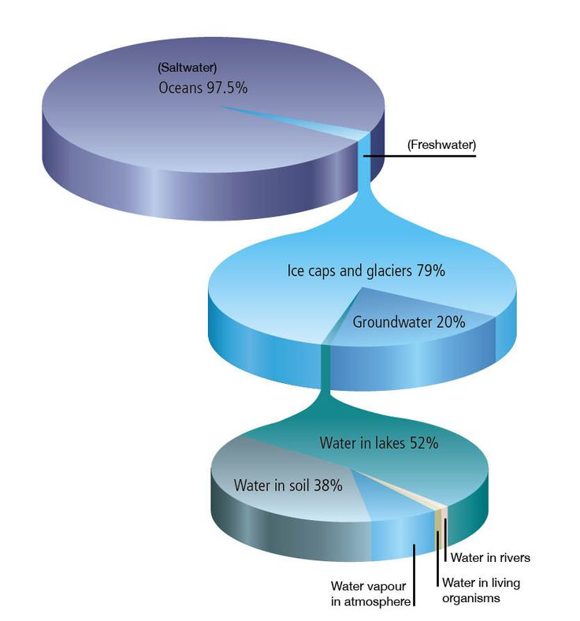
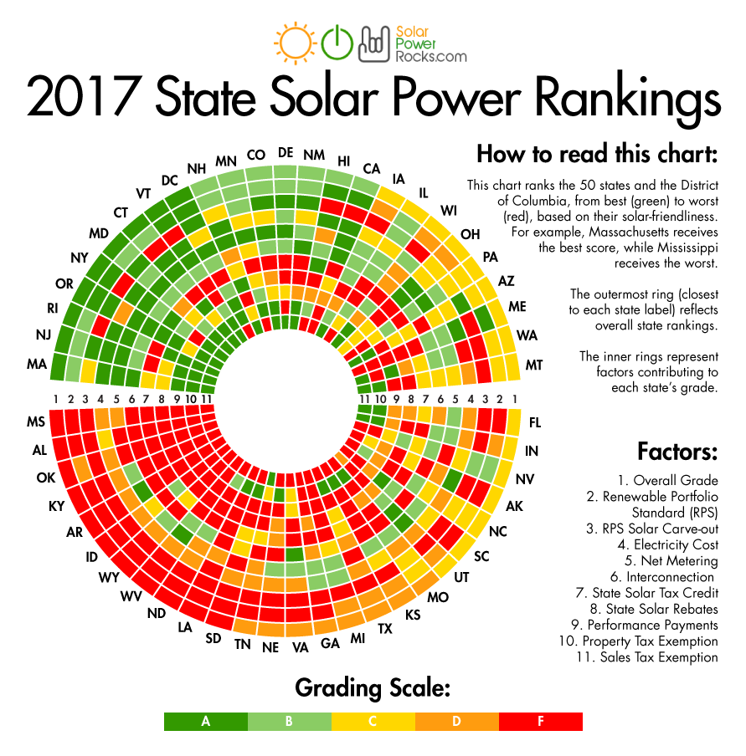
Relate Part to Whole Pie Charts
No explanations needed!

Slide 14
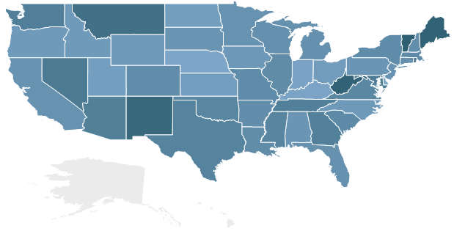
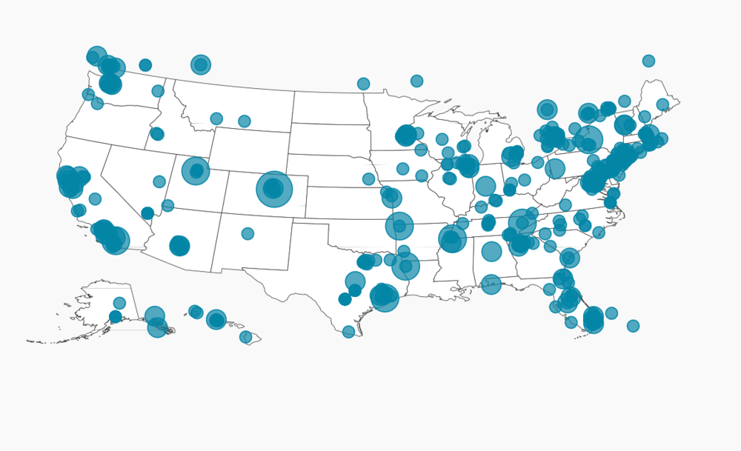
Maps
Bubble Markers
Pinpointed to coordinates
Size and density proportional to values
Heat Map
State borders polygons
Color density proportional to value

Slide 15
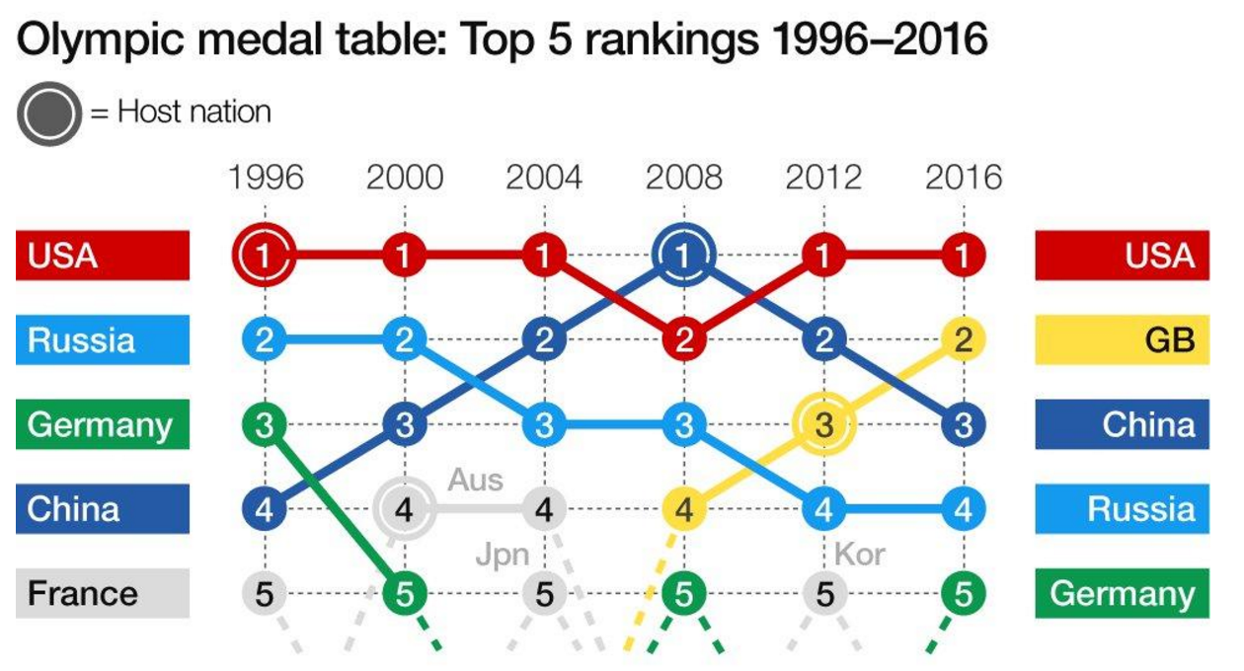
Ranking Charts

Slide 16
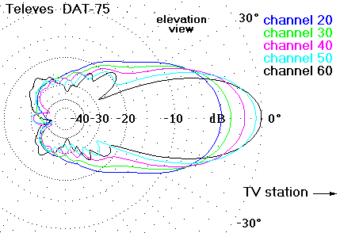
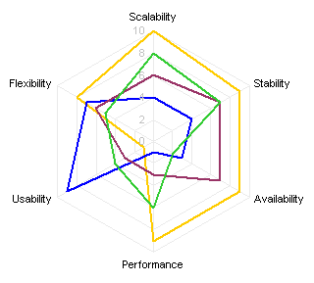
Radar Charts
Antenna Diagram
Attenuation
Vs. Direction
Spider Diagram
Quick way to assess on multiple parameters

Slide 17
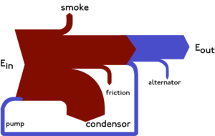
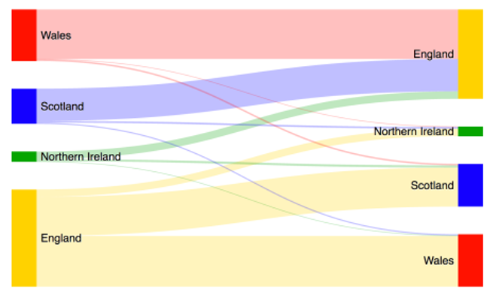
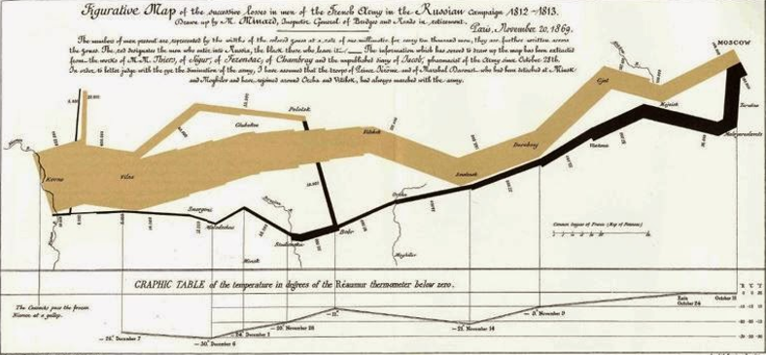
Sankey Diagram
Steam Engine Diagram
Migration Between UK Countries
Remember Charles Minard?

Slide 18
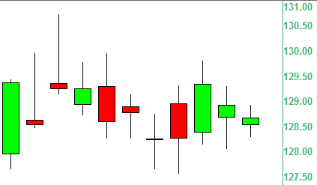
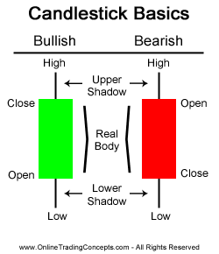
Special: Candlestick Diagram
(Shows Statistics: Range 1, Range 2, Gradient)

Slide 19
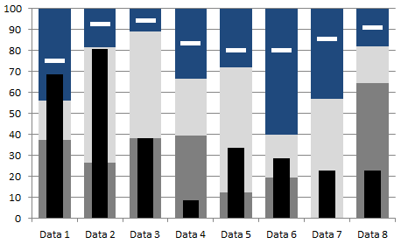
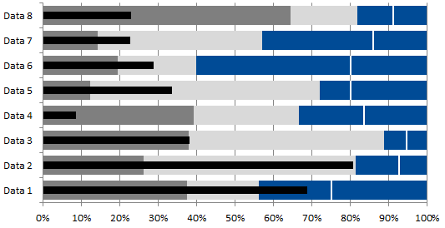
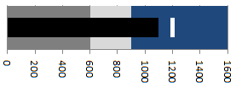
Special: Bullet Chart
Compares current value to target, previous, and objective
Bad
Good
Current
Objective

Slide 20
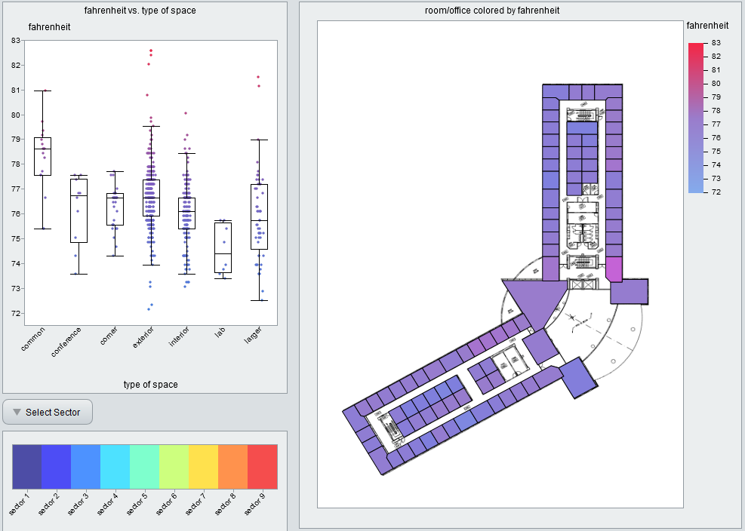
Building Air Temperature

Slide 21
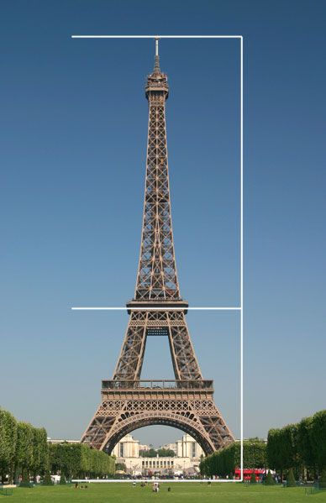
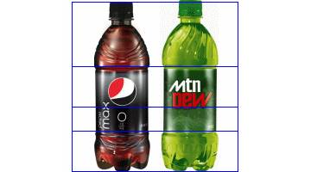
Composition Rules
The visualization shall please the eye
People spend more time with something they like
People are more forgiving for what they like
The eye likes
Symmetries, balance
Golden ratio (Phi = 1.618…)

Slide 22
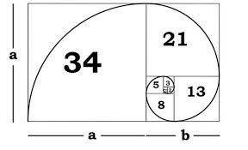
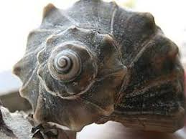

Golden Ratio (Fibonacci) Spiral (1,2,3,5,8,13,21…)
Phi =

Slide 23

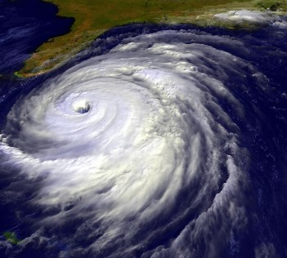
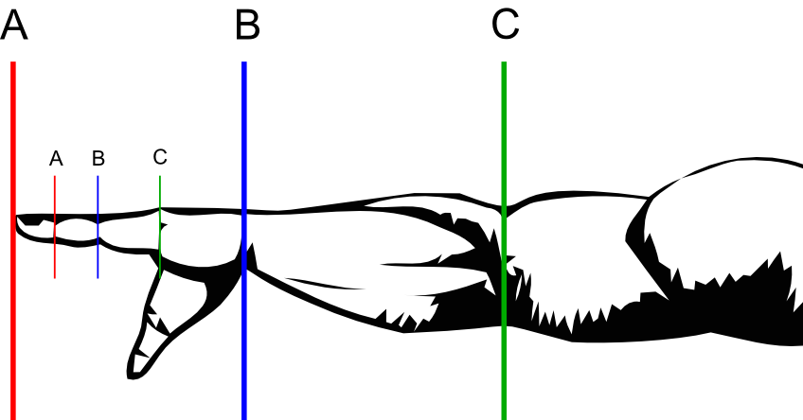
Golden Ratio in Nature

Slide 24
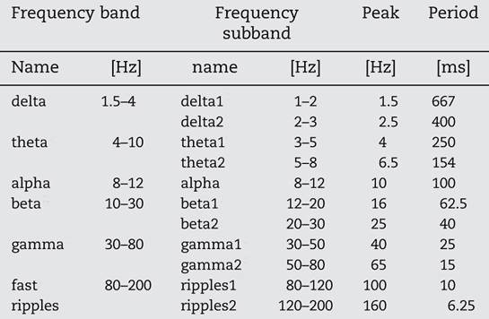
Brain Wave Frequencies
The classical frequency bands of the EEG can indeed be described as a geometric series with a ratio between neighboring frequencies approximating F = 1.618
1,2,3,5,8 - Fibonacci Sequence => Golden Ratio = n/(n-1) = 1.618
http://www.i-sis.org.uk/Golden_Music_of_the_Brain.php

Slide 25
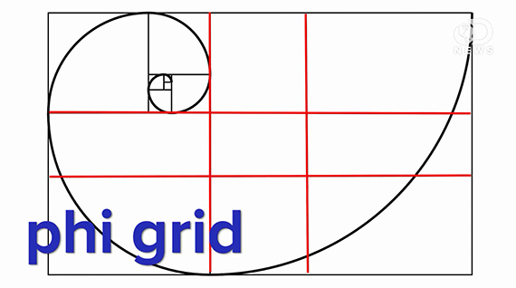

Phi Grid

Slide 26
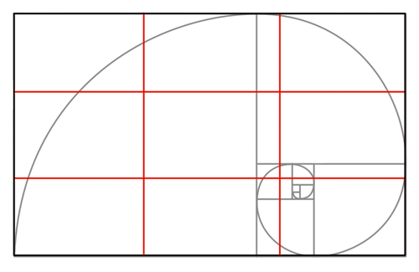
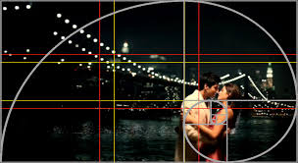
Rule of Thirds Phi Grid for “Dummies”
When quick action is needed – like when making a photo - use “Rule of Thirds”

Slide 27
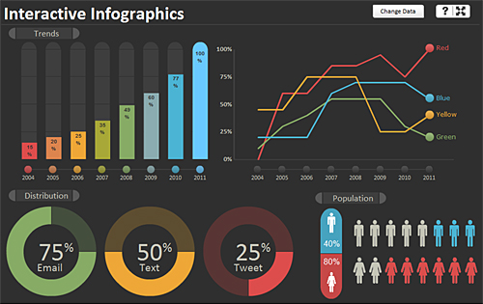
Dashboard Composition Example
Vertical Symmetry
Golden
Ratio
Central
Balance
Golden Ratio

Slide 28
Colors
“…the first principle in bringing color to information: above all, do no harm.”
(Envisioning Information, Edward Tufte,
Graphics Press, 1990)
Poor choice of colors will obscure, muddle, confuse or irritate
If possible, use color palettes provided by visualization tool
If not, create customer-matching palettes
Use customer logos or webpages
Extract color codes
Use online tools

Slide 29
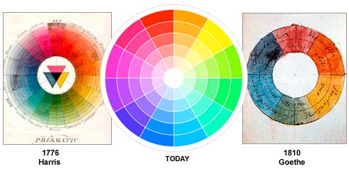
Color Theory
First color circle was developed by Isaac Newton in 1666
Analogues colors are adjacent
Complementary colors are opposite
https://monoskop.org/images/4/46/Itten_Johannes_The_Elements_of_Color.pdf

Slide 30

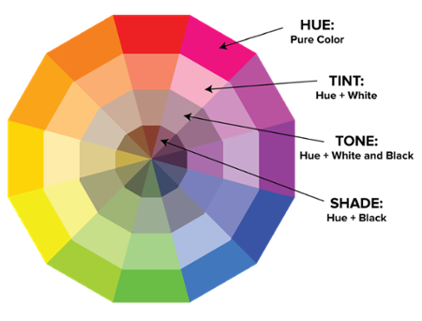
Essential Color Terminology

Slide 31
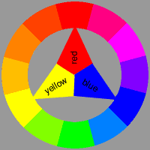
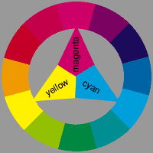
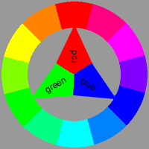
Why Printers and Monitors Use Different Primary Colors?
You can get (almost) any color from either RGB or RYB (or other primary set)
Note: magenta, yellow, cyan cannot make black, hence there is black cartridge in printers
You can mix colors by adding or subtracting (light)
When you paint, you subtract light by adding another paint (reduce the amount of light going through – light is “subtracted”)
Subtractive color wheel gives black when all colors are added
Additive color wheel gives white when all colors are added
Color wheel
for painting
Color wheel
for printing
Color wheel
for projecting

Slide 32
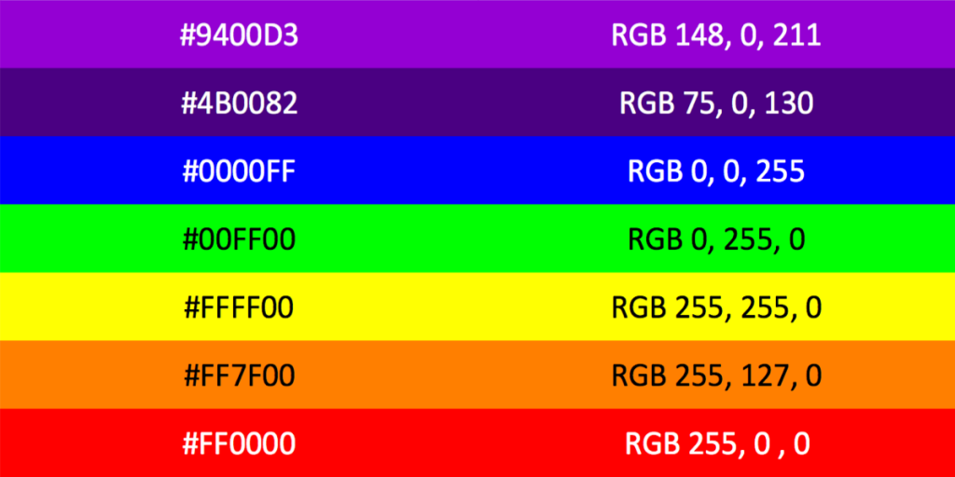
Color Codes
Hex Color Codes - Websites
RGB Color Codes - Screens
#FFFFFF
255,255,255
#000000
0,0,0,
#XXXXXX
XXX,XXX,XXX
https://htmlcolorcodes.com/
https://www.rapidtables.com/web/color/RGB_Color.html

Slide 33
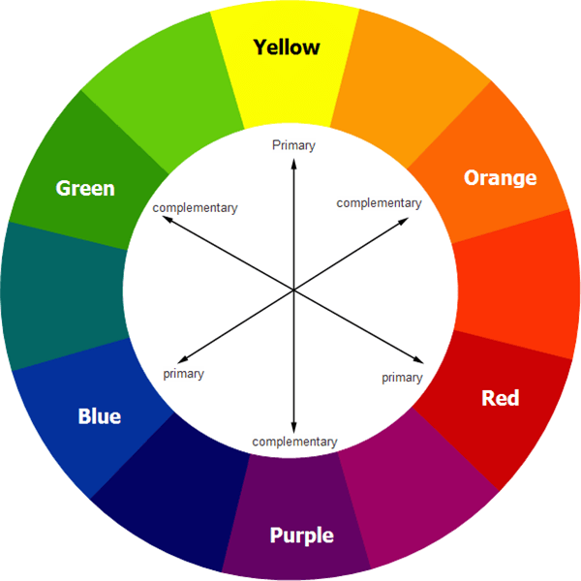
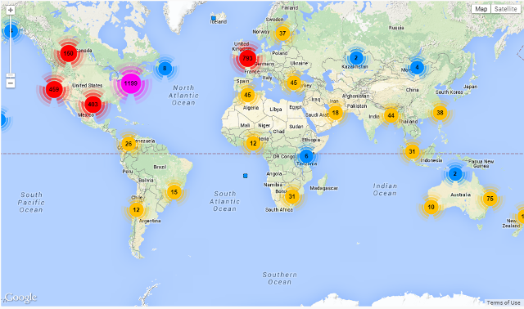
Contrast Colors
Contrast colors draw attention
Make things distinct
Use color wheels to pick complementary contrast color

Slide 34
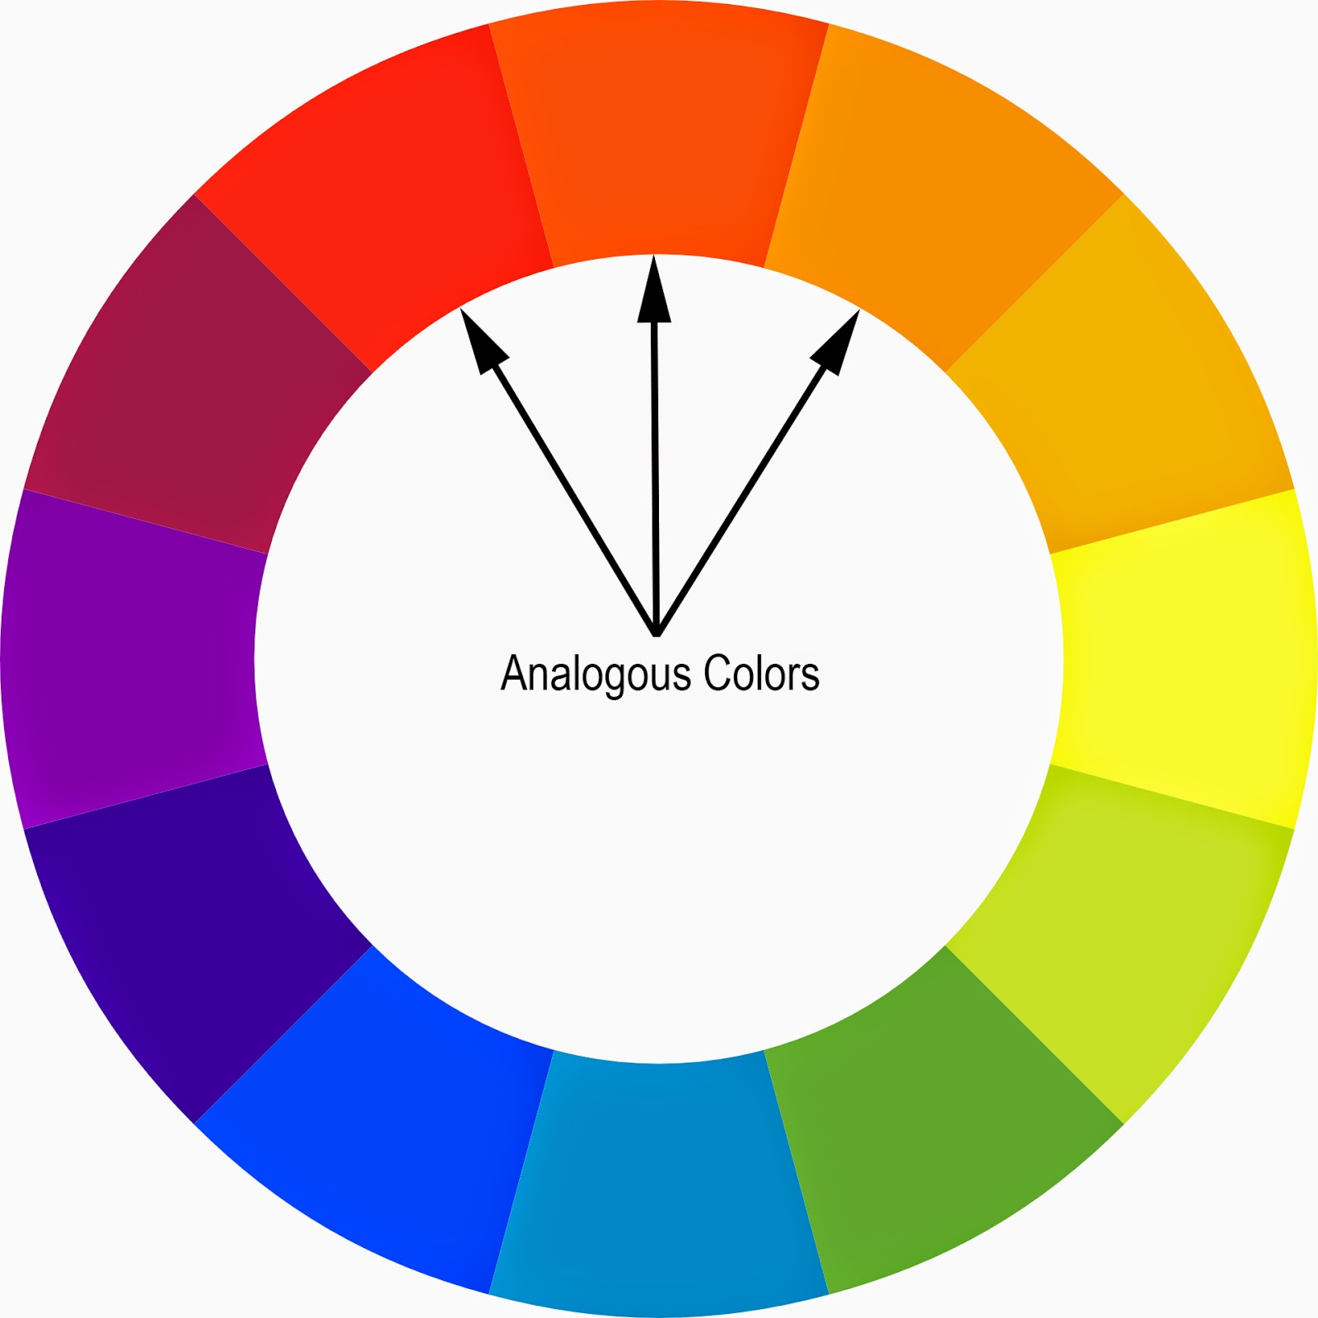
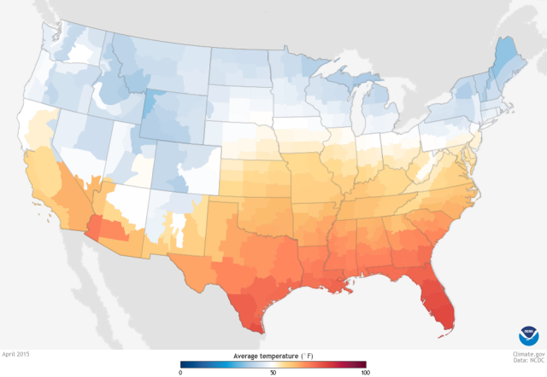
Analogous Colors
Analogous colors suggest grouping
Use them to show gradual changes

Slide 35
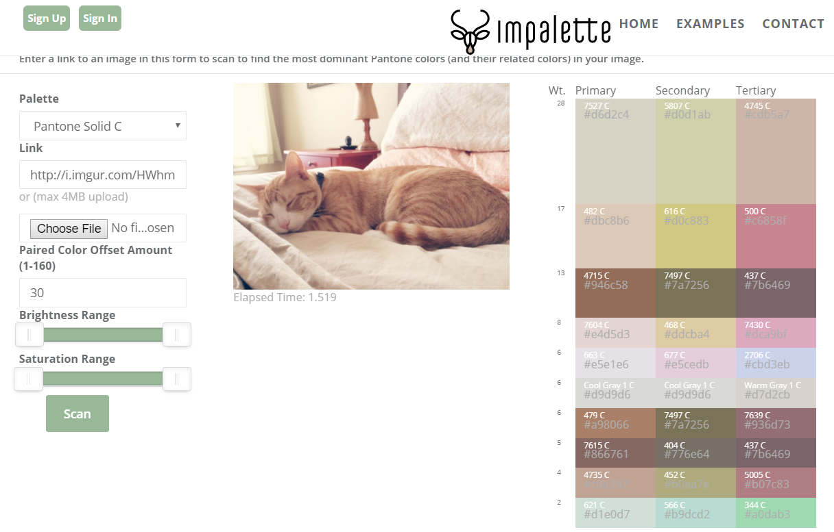
Match Customer Colors
Use online tools to create customer-matching palettes
e.g.: https://www.impalette.com/

Slide 36
Interactivity
Interactivity improves usability when
Intuitive
Forgiving (e.g., can get back to where you where)
Most common interactivity features
Sort
E.g.: descending, ascending, alphabetically, top 10, etc.
Filter
Exclude variables based on a parameter
Drill down
Path values from one visualization to another
Works best with established hierarchies

Slide 37
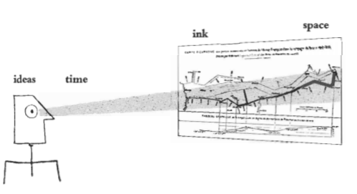
Edward Tufte’s Principles of Graphical Excellence*
Complex ideas communicated with
Clarity
Precision
Efficiency
Greatest number of ideas in shortest time
with least ink in the smallest space
*Edward Tufte, The Visual Display of Quantitative Information

Slide 38
Edward Tufte’s Visualization Guidelines*
Show the data
Induce the viewer to think over the substance, not graphic design, technology, etc.
Do not distort what the data have to say
Present many numbers in small space
Make large data sets coherent
Encourage the eye to compare different pieces of data
Reveal the data at several layers of detail, from broad to fine
Serve a clear purpose: description, explorations, tabulation, or decoration
Be closely integrated with statistical and verbal descriptions of a data set
*Edward Tufte, The Visual Display of Quantitative Information

Slide 39
MicroStrategy Examples
MicroStrategy Desktop is free
Create data extracts in R
Add data to MSTR desktop
Create dashboards
Save, and export as PDF
https://www.microstrategy.com/us/desktop

Slide 40
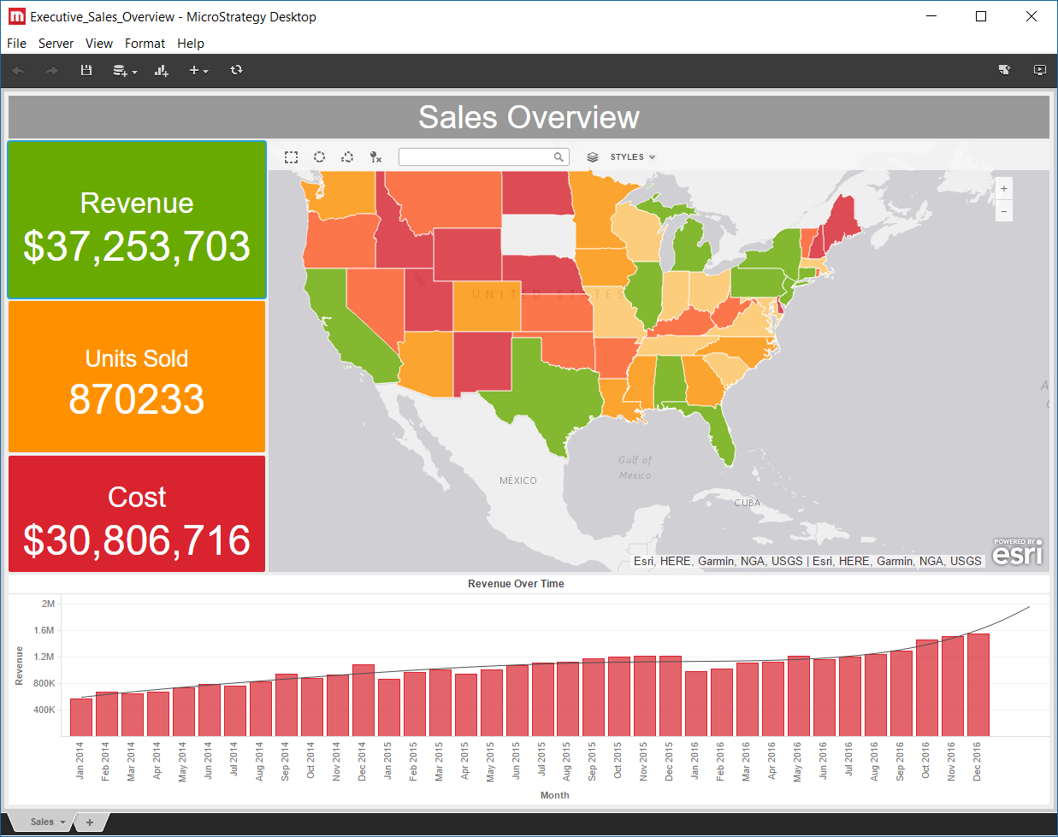

Slide 41
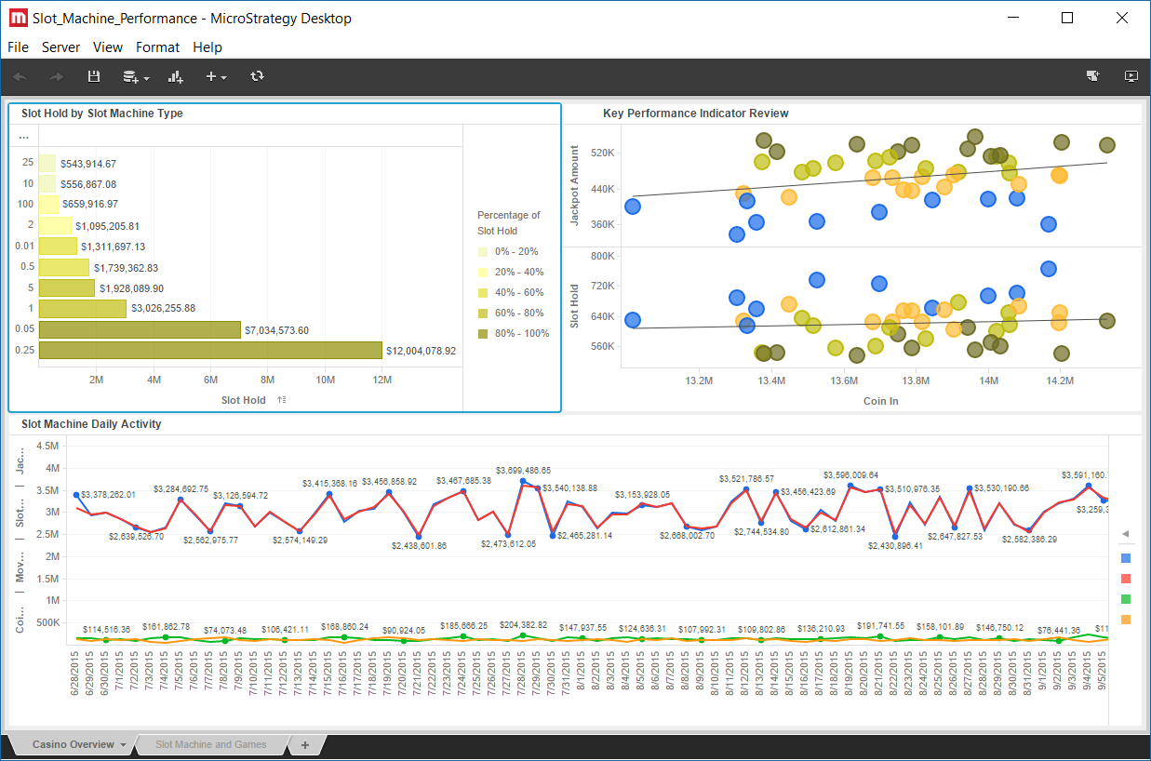

Slide 42


Slide 43


Slide 44
Q & A

